Slide 1
Good Afternoon!
Prepared By:
Alily Joy A. Dela Marquez
Student Teacher in English

Slide 2
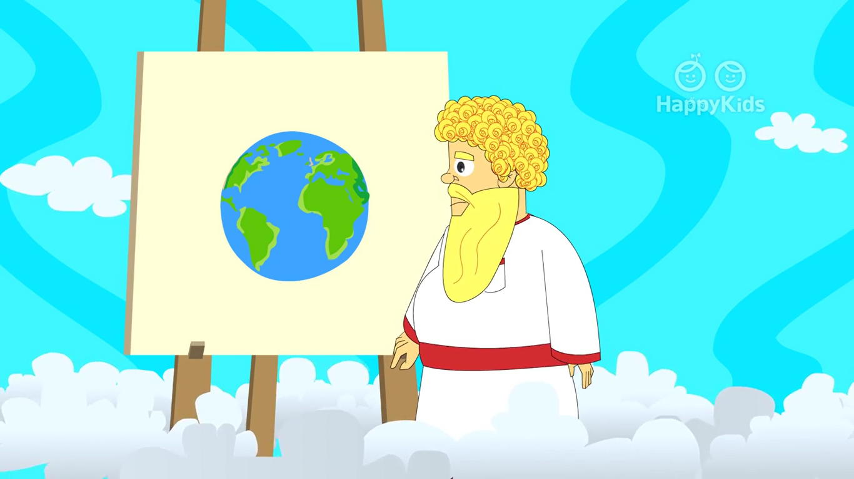
God is good all the time

Slide 3
“Reverse Me”

Slide 4
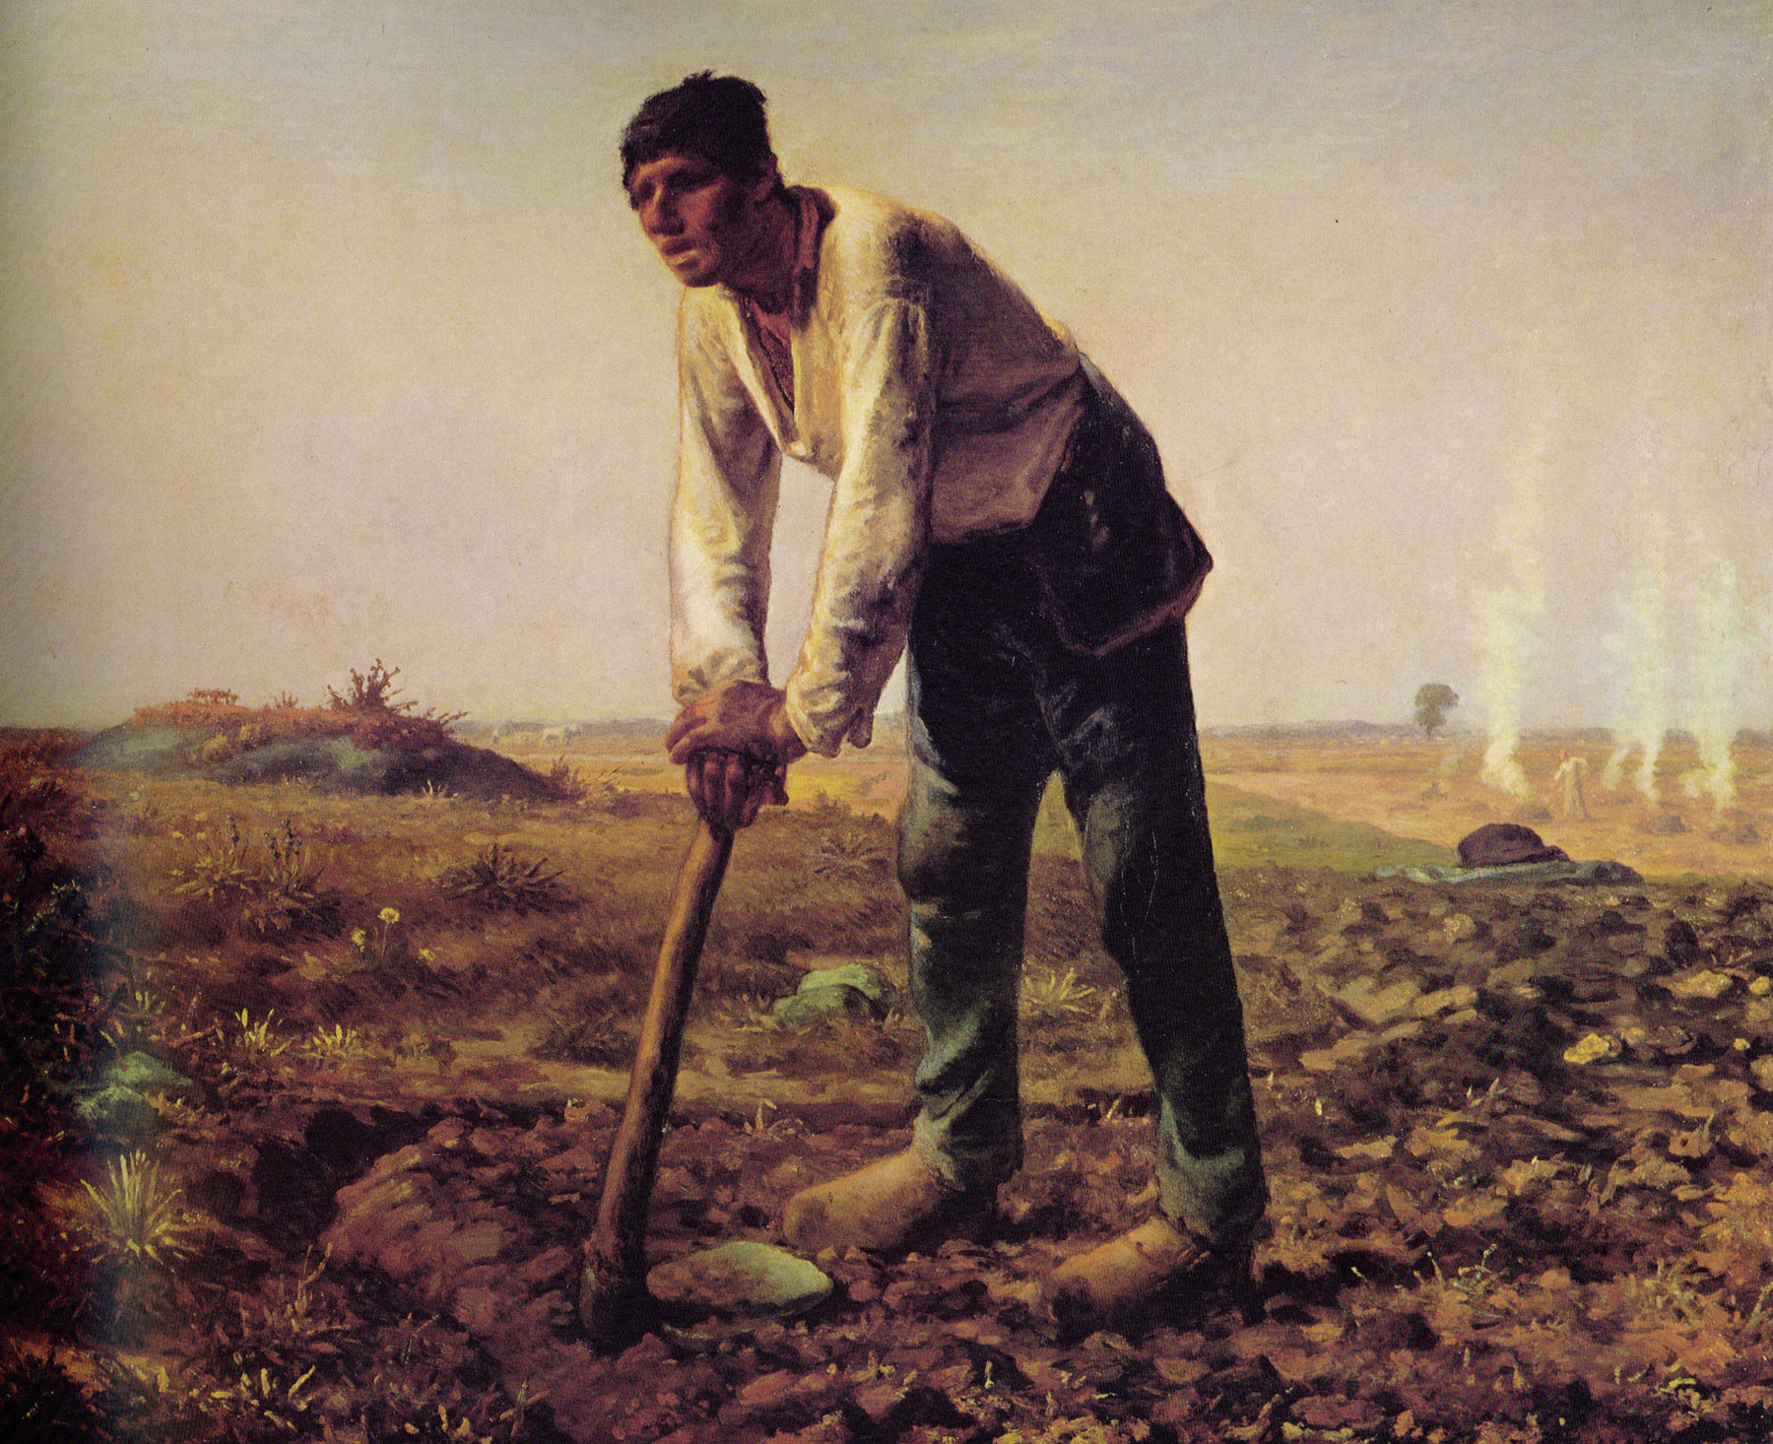

Slide 5
Presentation of objectives
During and at the end of the one-hour session, at least 75% of the students are expected to:
A. Identify the theme of the poem “The Man with the Hoe”;
B. Share their own varied interpretations on the given stanza from the poem through illustration;
C. Show appreciation of the literary selection through a slogan, poem, song, poster or TV advertisement; and
D. Construct a poem which will show the importance of a farmer.

Slide 6
Lesson Proper

Slide 7
The Man with a Hoe by Edwin Markham
Bowed by the weight of centuries he leans
Upon his hoe and gazes on the ground,
The emptiness of ages in his face,
And on his back, the burden of the world.
Who made him dead to rapture and despair,
A thing that grieves not and that never hopes,
Stolid and stunned, a brother to the ox?
Who loosened and let down this brutal jaw?
Whose was the hand that slanted back this brow?
Whose breath blew out the light within this brain?

Slide 8
Is this the Thing the Lord God made and gave
To have dominion over sea and land;
To trace the stars and search the heavens for power;
To feel the passion of Eternity?
Is this the dream He dreamed who shaped the suns
And marked their ways upon the ancient deep?
Down all the stretch of Hell to their last gulf
There is no shape more terrible than this--
More tongued with censure against the world's blind greed--
More filled with signs and portents for the soul--
More packed with danger to the universe.
What gulfs between him and the seraphim!

Slide 9
Slave of the wheel of labor, what to him
Are Plato and the swing of the Pleiades?
What the long reaches of the peaks of song,
The rift of dawn, the reddening of the rose?
Through this dread shape the suffering ages look;
Time's tragedy is in that aching stoop;
Through this dread shape humanity betrayed,
Plundered, profaned and disinherited,
Cries protest to the Powers that made the world,
A protest that is also prophecy.

Slide 10
O masters, lords and rulers in all lands,
Is this the handiwork you give to God,
This monstrous thing distorted and soul-quenched?
How will you ever straighten up this shape;
Touch it again with immortality;
Give back the upward looking and the light;
Rebuild in it the music and the dream;
Make right the immemorial infamies,
Perfidious wrongs, immedicable woes?

Slide 11
O masters, lords and rulers in all lands,
How will the future reckon with this Man?
How answer his brute question in that hour
When whirlwinds of rebellion shake all shores?
How will it be with kingdoms and with kings--
With those who shaped him to the thing he is—
When this dumb Terror shall rise to judge the world,
After the silence of the centuries?

Slide 12
Mechanics:
  Each group (with the same groupings) will be given a blank paper to illustrate/ sketch how they interpret the stanza that they read from the poem within 3 minutes.
  Each group will have a representative to present their work.

Slide 13
Rubric:
Content - 25%
Originality - 25%
Creativity - 15%
Relevance - 10%
Teamwork - 25%
100%

Slide 14
Presentation

Slide 15
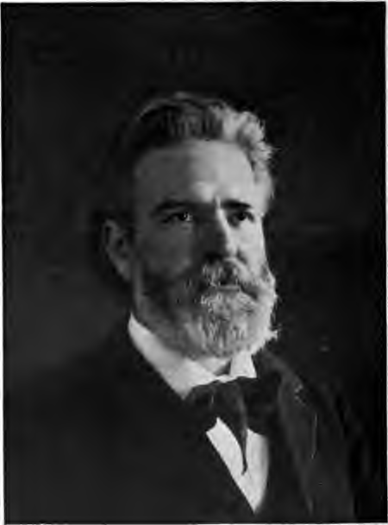
Charles Edwin Anson Markham
born on April 23, 1852 in Oregon City, Oregon
the youngest of six children.
Markham dropped the name Charles in about 1895 and became Edwin.
In 1898, Markham married his third wife, Anna Catherine Murphy.
That same year, Markham read "The Man with the Hoe," inspired by Millet’s painting by that title, at a New Year’s Eve party; the poem, which protested the plight of the exploited laborer, was soon published and became an instant success.
Markham died on March 7, 1940 in Brooklyn, New York.
Edwin Markham

Slide 16
EVALUATION
In a ½ lengthwise, make your own poem about the importance of farmer in our society. You will be graded with these criteria;
Content – 50%
Organization – 25%
Relevance – 25%
_______
100%

Slide 17
ASSIGNMENT
Copy and answer the following questions in your notebook.
1. What is Sonnet?
2. What are the specific features of a sonnet?
3. Give the two types of Sonnet.

